Slide 1
Red Hat OpenShift Virtualization

Slide 2
Basics of Virtualization
https://docs.google.com/presentation/d/1r4dCx1bdDOXsIgASG2khPwgOaSjqYZrxlQVsIoCmwFw/edit?usp=sharing

Slide 3
Red Hat OpenShift Virtualization
OpenShift Virtualization is an add-on to OpenShift Container Platform
Red Hat OpenShift Virtualization is a Kubernetes operator on RHOCP.
Based on the KubeVirt
Enables managing VM workloads alongside container workloads.
KubeVirt delivers container-native virtualization by using the Kernel-based Virtual Machine (KVM) Linux Kernel hypervisor within a Kubernetes container.
Started by Red Hat, KubeVirt is now a Cloud Native Computing Foundation Incubation project and an open source upstream project.

Slide 4
What you can do with OpenShift Virtualization
Creating and managing Linux and Windows virtual machines (VMs)
Running pod and VM workloads alongside each other in a cluster
Connecting to virtual machines through a variety of consoles and CLI tools
Importing and cloning existing virtual machines
Managing network interface controllers and storage disks attached to virtual machines
Live migrating virtual machines between nodes
Migrate from other virtualization Platforms.

Slide 5
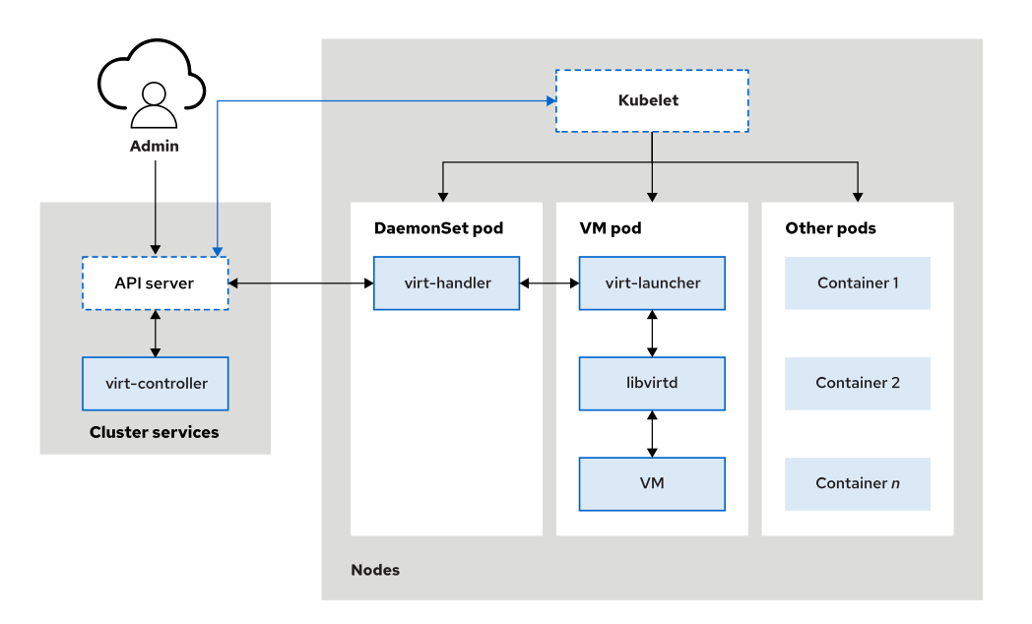
The cluster API server communicates with the virt-controller process to orchestrate virtual machine requests.

Slide 6
2. A DaemonSet pod that contains the virt-handler process coordinates with the VM pod that runs the virt-launcher process to deliver the VM actions.

Slide 7
3. Within the VM pod, the 'libvirtd' daemon provides the functionality for performing specific VM actions at the kernel level.

Slide 8
Virtualization Components

Slide 9
virt-api
A cluster-level component that provides an HTTP RESTful entry point to manage VM and VM-related workflows within the cluster.
It updates virtualization CRDS and handles defaulting and validating VMI CRDs.

Slide 10
virt-controller
The virt-controller is a Kubernetes Operator that’s responsible for cluster-wide virtualization functionality.
When new VM objects are posted to the Kubernetes API server, the virt-controller takes notice and creates the pod in which the VM will run.
When the pod is scheduled on a particular node, the virt-controller updates the VM object with the node name, and hands off further responsibilities to a node-specific KubeVirt component, the virt-handler, an instance of which runs on every node in the cluster.

Slide 11
virt-handler
Like the virt-controller, the virt-handler is also reactive, watching for changes to the VM object, and performing all necessary operations to change a VM to meet the required state.
The virt-handler references the VM specification and signals the creation of a corresponding domain using a libvirtd instance in the VM's pod.
When a VM object is deleted, the virt-handler observes the deletion and turns off the domain.

Slide 12
virt-launcher
Every VM object one pod is created.
Pod's primary container runs the virt-launcher KubeVirt component.
To provide the cgroups and namespaces which will be used to host the VM process.
virt-handler signals virt-launcher to start a VM by passing the VM's CRD object to virt-launcher.
virt-launcher then uses a local libvirtd instance within its container to start the VM.
From there virt-launcher monitors the VM process and terminates once the VM has exited.

Slide 13
libvirtd
An instance of libvirtd is present in every VM pod. virt-launcher uses libvirtd to manage the life-cycle of the VM process.

Slide 14
OpenShift Virtualization Architecture
The Operator Lifecycle Manager (OLM) deploys operator pods for each component of OpenShift Virtualization:
Compute: virt-operator
Storage: cdi-operator
Network: cluster-network-addons-operator
Scaling and templating: ssp-operator
OLM also deploys the hyperconverged-cluster-operator pod, which is responsible for the deployment, configuration, and life cycle of other components, and several helper pods: hco-webhook, and hyperconverged-cluster-cli-download.

Slide 15
After all operator pods are successfully deployed, you should create the HyperConverged custom resource (CR).
The configurations set in the HyperConverged CR serve as the single source of truth and the entrypoint for OpenShift Virtualization, and guide the behavior of the CRs.
The HyperConverged CR creates corresponding CRs for the operators of all other components within its reconciliation loop

Slide 16
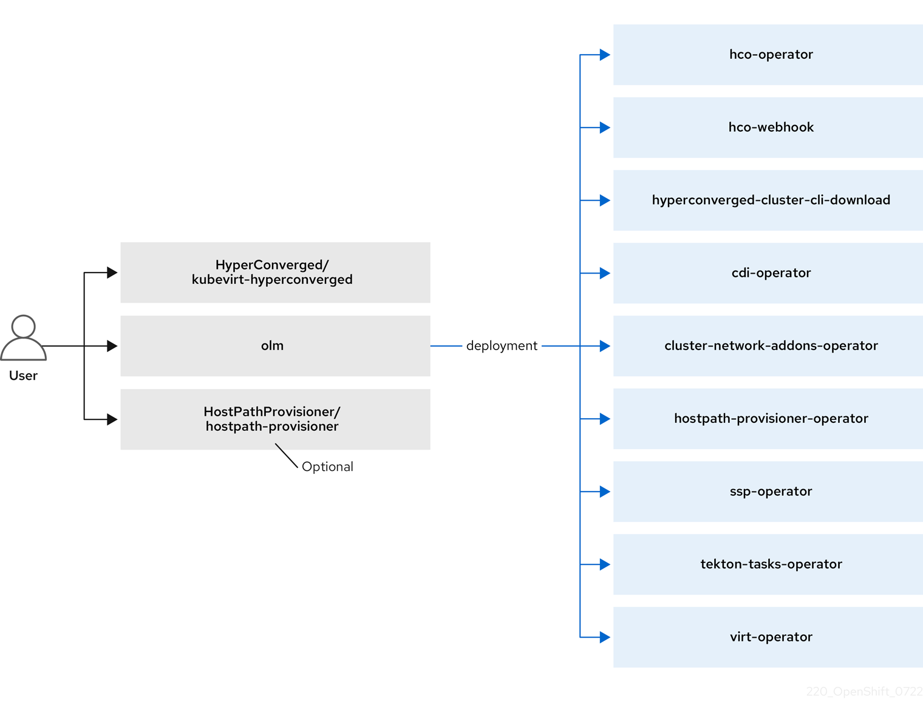

Slide 17
HyperConverged Operator (HCO)
The HCO, hco-operator, provides a single entry point for deploying and managing OpenShift Virtualization and several helper operators with opinionated defaults.
It also creates custom resources (CRs) for those operators.

Slide 18
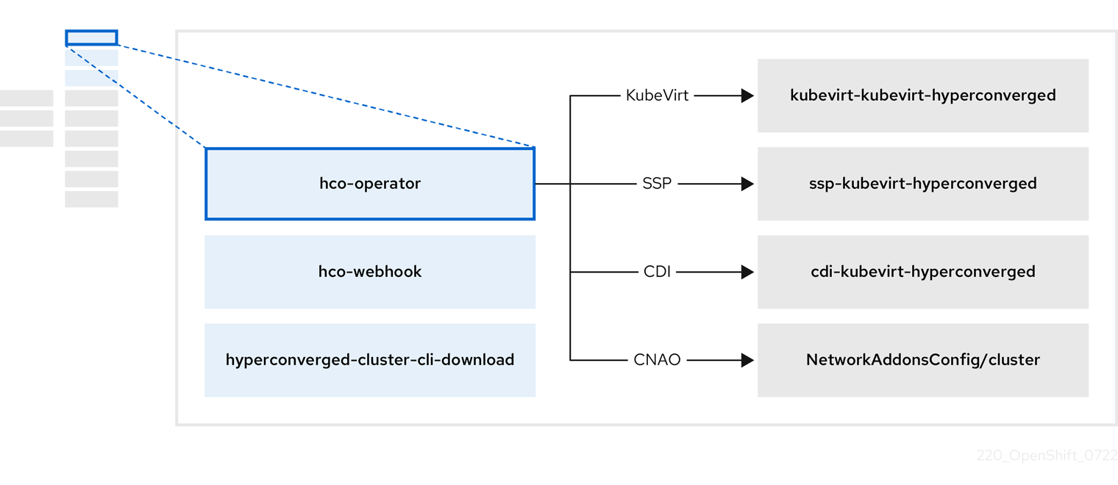

Slide 19
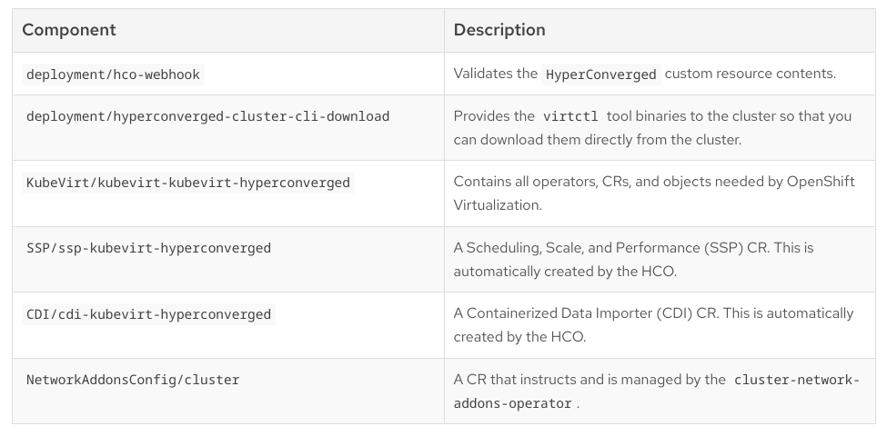

Slide 20
Containerized Data Importer (CDI) Operator
The CDI Operator, cdi-operator, manages CDI and its related resources, which imports a virtual machine (VM) image into a persistent volume claim (PVC) by using a data volume.

Slide 21
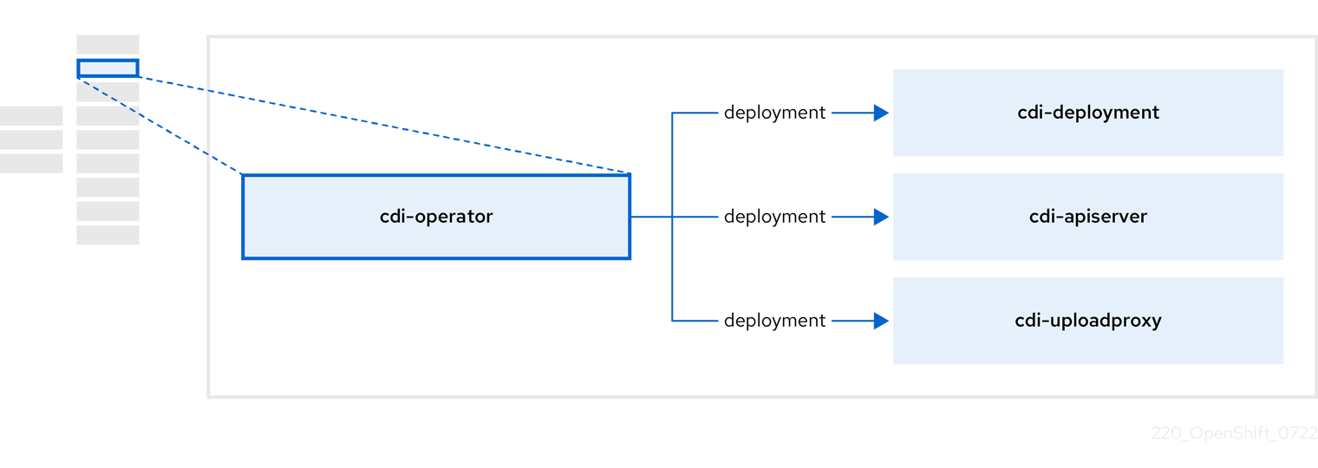

Slide 22
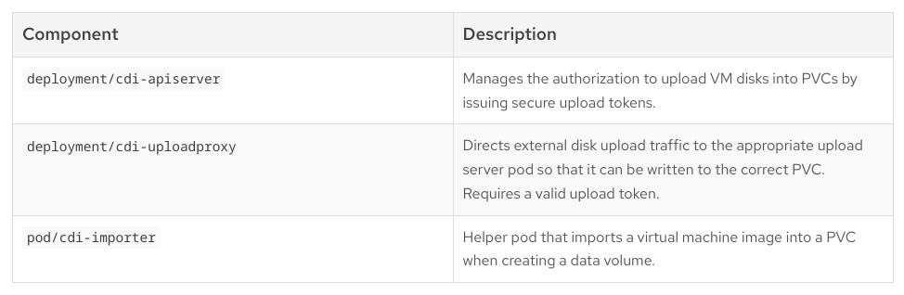

Slide 23
Cluster Network Addons Operator
The Cluster Network Addons Operator, cluster-network-addons-operator, deploys networking components on a cluster and manages the related resources for extended network functionality.

Slide 24
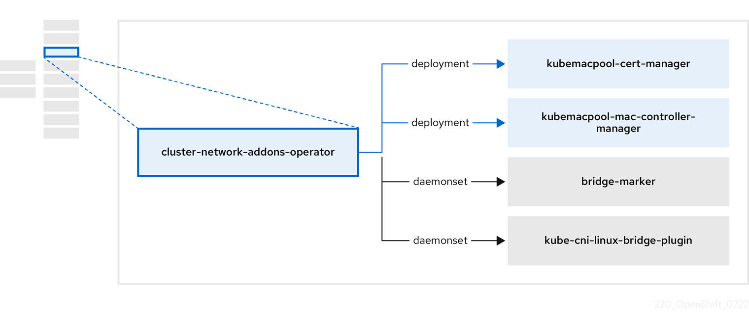

Slide 25
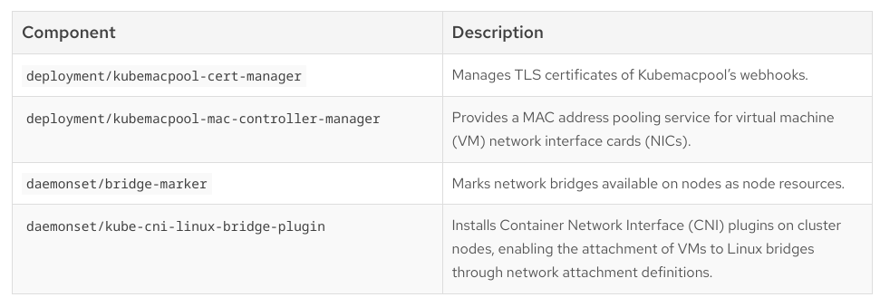

Slide 26
Hostpath Provisioner (HPP) Operator
The HPP Operator, hostpath-provisioner-operator, deploys and manages the multi-node HPP and related resources

Slide 27
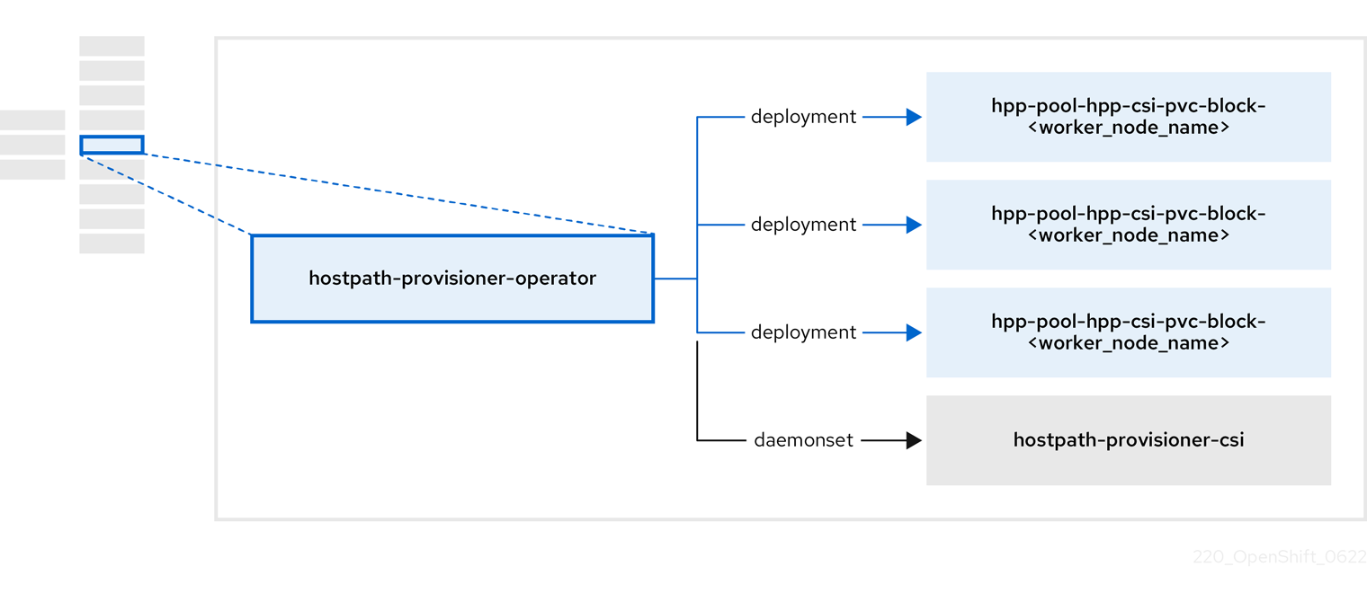

Slide 28
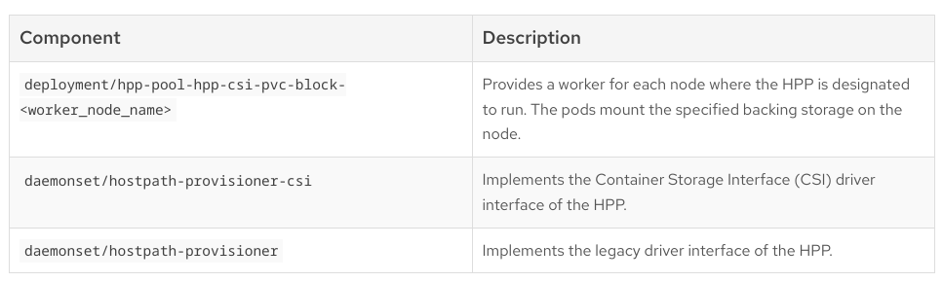

Slide 29
Scheduling, Scale, and Performance (SSP) Operator
The ssp-operator deploys the common templates, the related default boot sources, and the template validator.

Slide 30
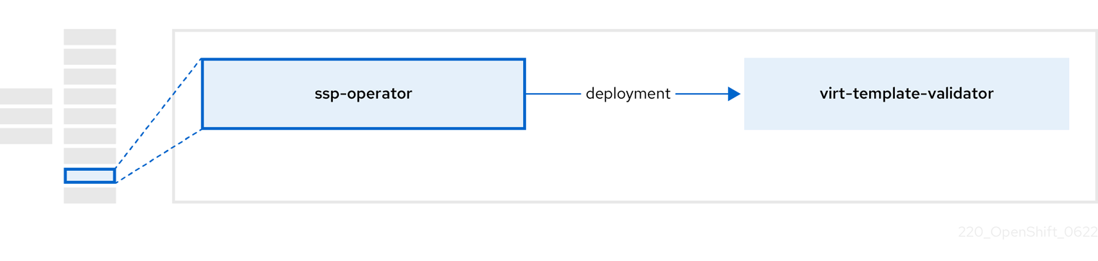

Slide 31
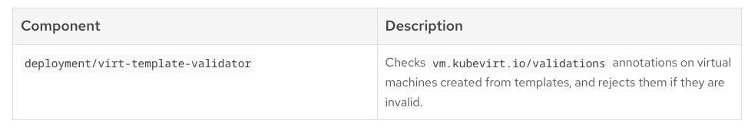

Slide 32
OpenShift Virtualization Operator
The OpenShift Virtualization Operator, virt-operator deploys, upgrades, and manages OpenShift Virtualization without disrupting current virtual machine (VM) workloads.

Slide 33
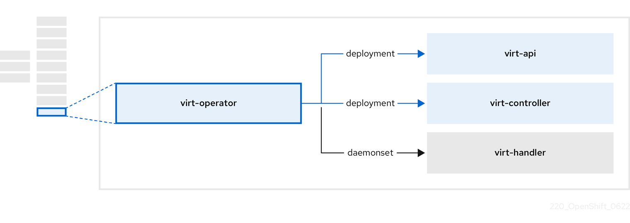

Slide 34
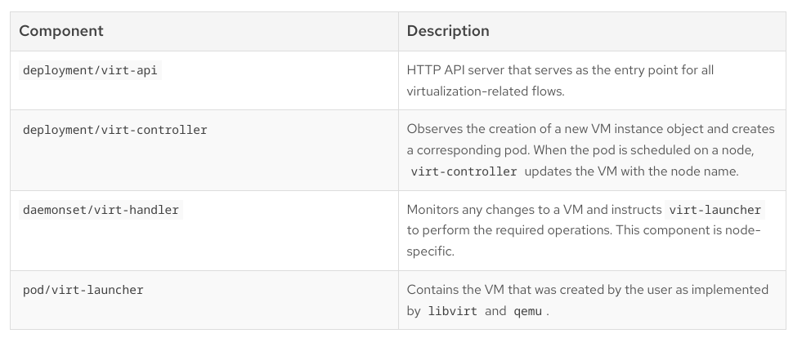

Slide 35
Chapter-2
VM : A VM object specifies the template for a VMI pod
VMI: Running instance of a VM
Similar to the relationship between a deployment and a replica set
Stand-alone VMI
RBAC

Slide 36
Chapter-3
Kubernetes implements this infrastructure with the use of a Software-Defined Network (SDN), which enables Kubernetes to control the network traffic and the network resources programmatically.
Red Hat OpenShift Container Platform (RHOCP) uses the Cluster Network Operator (CNO) for managing the SDN. The operator calls a plug-in that adheres to the Container Network Interface (CNI) specification to configure container network interfaces.
The OVN-Kubernetes provider, which runs the Open vSwitch (OVS) plug-in on each node, is selected by default during the installation process.

Slide 37
Expose application
Route
Ingress
NodePort
Non-HTTP services .Expose node port ranges 30000 to 32767 on all cluster nodes
LoadBalancer
Non HTTP services. Instructs RHOCP to activate a load balancer in a cloud environment.Provides an externally accessible IP.
Secure Routes: Edge,Pass-through,Reencryption
Path-based routes
NetworkPolicy
Enable traffic from Router Pods
MetalLB Operator https://docs.google.com/presentation/d/16IvbiyJ5gDUv2C9sNSmnEpjUfNeYEQiBOnQkcR75gR4/edit?usp=sharing
Multus https://docs.google.com/presentation/d/14624JDH6-V8fNb6bqMzfp1EJ3xGaMmaV8_wOpwM70L4/edit?usp=sharing
Kubernetes NMState Operator https://docs.google.com/presentation/d/1uJOSW-5Vv36Ng7wLLONVydGZCZ6MoFSuF8z6MjHQ7Yg/edit?usp=sharing

Slide 38
Multus CNI
https://docs.google.com/presentation/d/14624JDH6-V8fNb6bqMzfp1EJ3xGaMmaV8_wOpwM70L4/edit?usp=sharing
RedHat recommends using the Cluster Network Operator (CNO) to centralize managing additional networks for pods in clusters where the OpenShift Virtualization operator is not deployed.
For VMs in OpenShift Virtualization, you do not need to edit the CNO to create a network attachment definition.
To attach additional network interfaces to a pod or a VM, you must create a network attachment definition that defines the CNI plug-in configuration to use for the additional interface.

Slide 39
RHOCP provides the following CNI plug-ins for the Multus CNI plug-in to chain:
  Bridge
  Host-device
  Ipvlan
  Macvlan
  SR-IOV

Slide 40
Configuring Kubernetes Storage for Virtual Machines
CSI https://docs.google.com/presentation/d/10mqwsnZr8t5i7qpb_1VW-404CJwnbefEh-fzraBTiKk/edit?usp=sharing
Ephemeral storage
Persistent storage
PersistentVolume [Kubernetes Resource]
PersistentVolumeClaim [Kubernetes Resource]
Volume Provisioning: Static Vs Dynamic
Volume Modes: Filesystem,Block
Volume Access Modes: RWO,RWX(VM Live Migration),ROX
StorageClass [Kubernetes Resource]
Storageclass Annotation
StorageProfile
Datavolume
Local Node Disk Space - No Live Migration support

Slide 41
CONTAINER STORAGE INTERFACE
https://docs.google.com/presentation/d/10mqwsnZr8t5i7qpb_1VW-404CJwnbefEh-fzraBTiKk/edit?usp=sharing

Slide 42
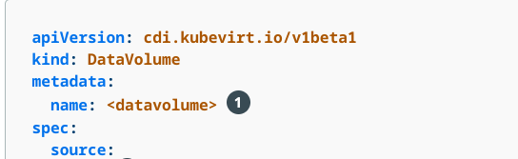
DataVolume
A data volume resource describes a VM disk.
Provided by the Containerized Data Importer (CDI) project
Groups the PVC definition and the details of the disk image to inject into the PV.
Data volumes are namespaced resources.

Slide 43
StorageProfile
When you create a data volume using the PVC API, the Containerized Data Importer (CDI) creates the data volume based on what you specify for the following fields:
  accessModes (ReadWriteOnce, ReadWriteMany, or ReadOnlyMany)
  volumeMode (Filesystem or Block)
  capacity of storage (5Gi, for example)
  A storage profile defines the PVC default values that are best suited for VM disks
  Storage profiles are cluster-wide resources.
  Storage profiles have the same name as their associated storage classes.

Slide 44
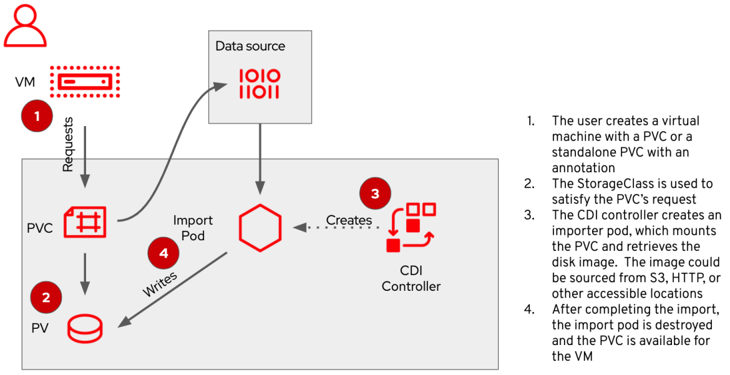

Slide 46
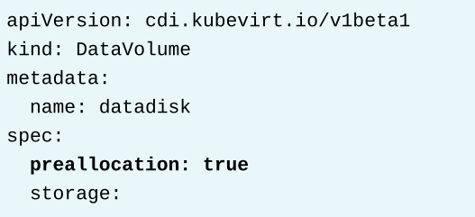
Preallocating Disk Space
Resize a Virtual Machine Disk-Only expansion
  allowVolumeExpansion in storageclass
  No stopping required.
  VM detects only after restart

Slide 47
Connect a Virtual Machines to External Storage
Connect the storage from inside the VM.
Connect the storage through a Kubernetes PV and then attach the volume as a VM disk.
Attach PV to VM
Inject DIskimage to VM
Attach the external Volume as Disk

Slide 48
Virtual Machine Templates
Default parameters that you can customize according to your needs.
RHOCP provides templates for several resource types,including network interfaces, PVs, and VMs.
RedHat OpenShift Virtualization provides a catalog of preconfigured templates to create a virtual machine and its resources.
Templates are available for different versions of Red Hat Enterprise Linux, CentOS, Fedora, Microsoft Windows 10 and 11, and Microsoft Windows Servers.
RedHat provides virtual machine templates that are preconfigured with the operating system image, default settings for the operating system, workload type, CPU, and memory resources.

Slide 49
Exporting and Importing Virtual Machines
OpenShift Virtualization can export VMs and their associated disks to import them into another OpenShift Virtualization cluster.
VirtualMachineExport(CR)

Slide 50
MTV
https://docs.google.com/presentation/d/1lqmdJJA7TKTvv2LpTj4rz4W3auGAL2mnAwxN647hWU0/edit?usp=sharing

Slide 51
Manage Virtual Machine Snapshots
A snapshot is a view of a Virtual Machine (VM) that includes the operating system and applications on all the attached disks at a given point in time.
With Red Hat OpenShift Virtualization, you can take live snapshots of running VMs, as well as snapshots of stopped VMs.
OpenShift Virtualization communicates with the Quick Emulator (QEMU) guest agent that is running inside the VM to quiesce the file systems before taking the snapshot .Ensure file consistent state.
Will work without qemu agent but file systems might not be consistent.
Disk snapshots rely on the back-end storage
Warning message for backend storage which does not support snapshot, no data restoration.
Records the VM configuration, such as the number of CPUs or the amount of memory

Slide 52
VirtualMachineSnapshot
VirtualMachineRestore
Can also duplicate individual VM disks from their snapshots
VM snapshots rely on Kubernetes volume snapshots

Slide 53
Cloning Virtual Machines
a copy of a VM
A clone likely has machine-specific data and configuration settings from the original VM
Sealing the VM is a process where you clear the machine-specific information
For Red Hat Enterprise Linux systems, use the virt-sysprep command
For Microsoft Windows systems, use the sysprep.exe command to initiate a System Out-of- Box-Experience (OOBE)
Red Hat OpenShift Virtualization provides the virtctl guestfs command to start a container that includes the virt-sysprep tool.

Slide 54
MASTER-API
Validates and write in etcd
STEP-2
VIRT-API-SERVER
Entry point for Virtualization
related flow
STEP-3
VIRT-CONTROLLER
Create and manage the
life-cycle of the pods
associated to the VMI objects
STEP-4
Observes the pod and Update nodeName in VMI [STEP-6]
virt-controller handover the
Responsibilities to virt-handler via virt-api
STEP-7
VIRT-HANDLER
VIRT-LAUNCHER
[POD]
LIBVIRT [Process]
QEMU/KVM [Process]
STEP-5
VirtualMachine
USER
oc create -f vm.yml
STEP-1

Slide 55
MASTER-API
Validates and write in etcd
STEP-2
VIRT-API-SERVER
Entry point for Virtualization
related flow
STEP-3
VIRT-CONTROLLER
Create and manage the
life-cycle of the pods
associated to the VMI objects
STEP-4
Observes the pod and Update nodeName in VMI [STEP-6]
VIRT-HANDLER
VIRT-LAUNCHER
[POD]
LIBVIRT [Process]
QEMU/KVM [Process]
STEP-5
VirtualMachine
USER
oc create -f vm.yml
STEP-1
STAND ALONE VM

